Slide 1
The Invisible Achievement Gap October 17, 2013

Slide 2
Methodology: Matching Process
Data sources: CALPADS and CWS/CMS
6-step matching process using personal information such as first name, last name, middle name, date of birth, city of schooling, and city of residence
Matching rate of over 80%
Final matched sample of 43,140 students with an open episode in foster care during the school year (August 1, 2009 and June 1, 2010) out of about 6 million K-12 students statewide

Slide 3
The Invisible Achievement Gap: Education Outcomes of Students in Foster Care in California’s Public Schools
By the numbers—the distribution of where students in foster care attend school
Key findings about the demographic and school characteristics of students in foster care
Key findings about the academic achievement and education outcomes of students in foster care

Slide 4
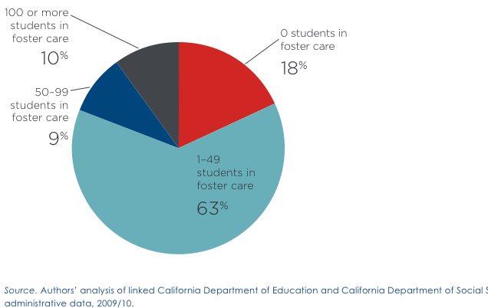
Distribution by District
193 (18%) school districts had no students in foster care
659 (63%) school districts had between 1-49 students in foster care
2/3 of students in foster care were enrolled in 10% of the school districts
81% of students in foster care were enrolled in 19% of the school districts
Figure 1. Distribution of students in foster care by district

Slide 5
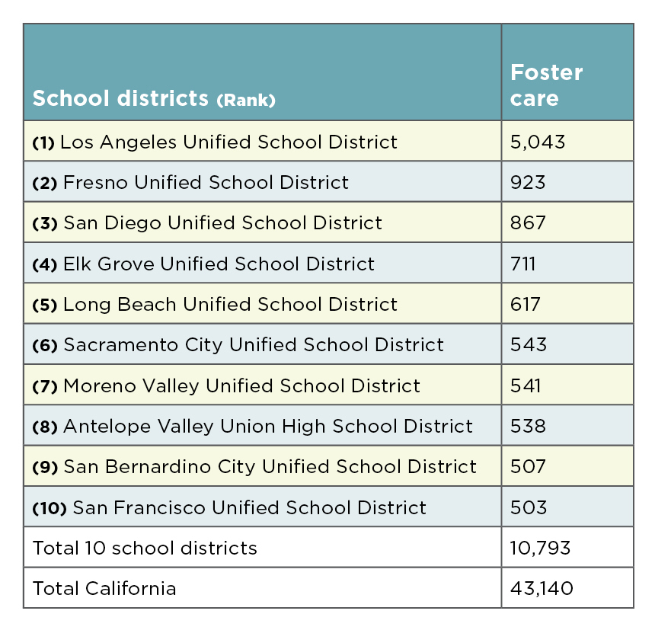
Table 2 Ten Districts with the Most Students in Foster Care

Slide 6
Key Findings
Demographic and school characteristics of students in foster care
Students in foster care constituted an at-risk subgroup that was distinct from low SES students.
Students in foster care were more likely to change schools during the school year.
Students in foster care were more likely than the general population of students to be enrolled in the lowest-performing schools.

Slide 7
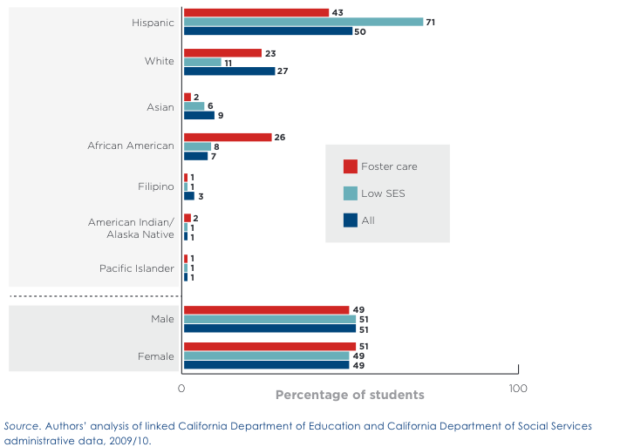
Figure 2 Distribution of students in foster care, low SES students, and all students by gender and race/ethnicity, 2009/10

Slide 8
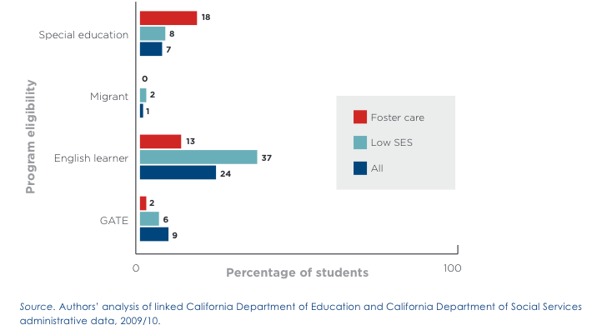
Figure 3 Percentage of students by program eligibility for students in foster care, low SES students, and all students, 2009/10

Slide 9
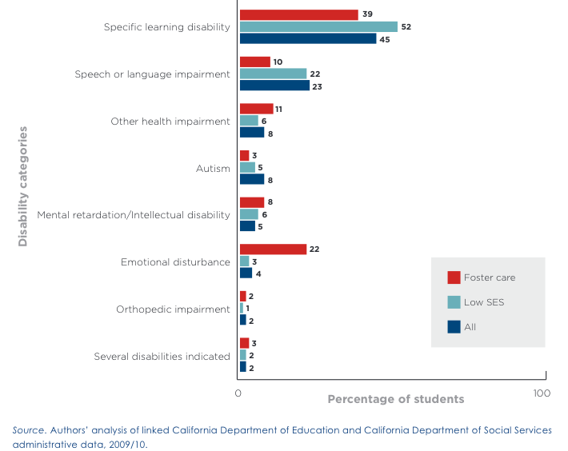
Figure 4 Percentage of students with disability by IDEA disability category for students in foster care, low SES students, and all students, 2009/10

Slide 10
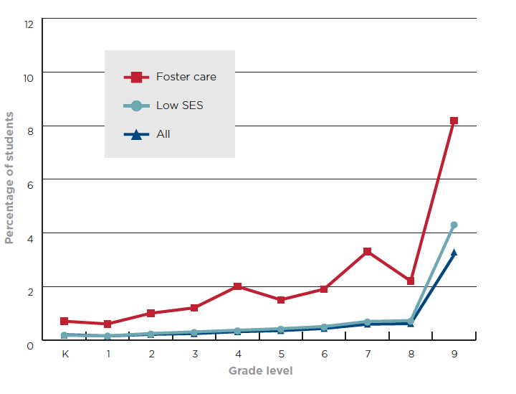
Figure 5 Percentage of students older than the median age by more than one year for students in foster care, low SES students, and all students, by grade level, grades K-9, 2009/10

Slide 11
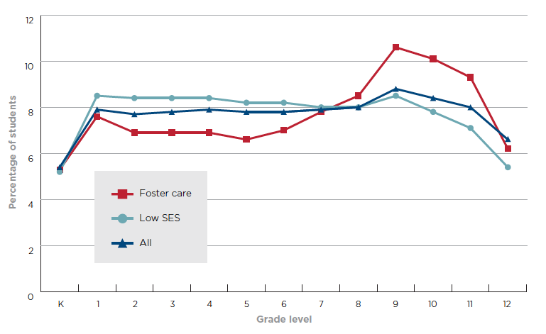
Figure 6 Distribution across grade levels at the beginning of the school year for students in foster care, low SES students, and all students, 2009/10

Slide 12
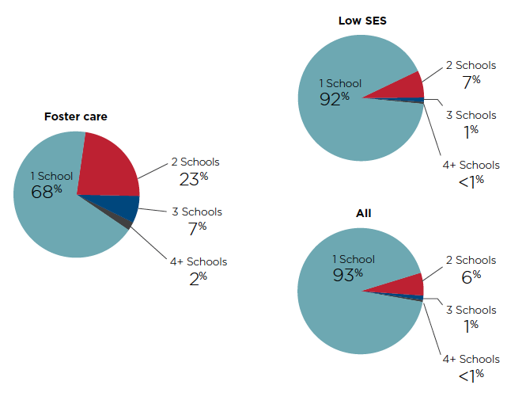
Figure 7 Distribution of the number of schools attended during the school year for students in foster care, low SES students, and all students, 2009/10

Slide 13
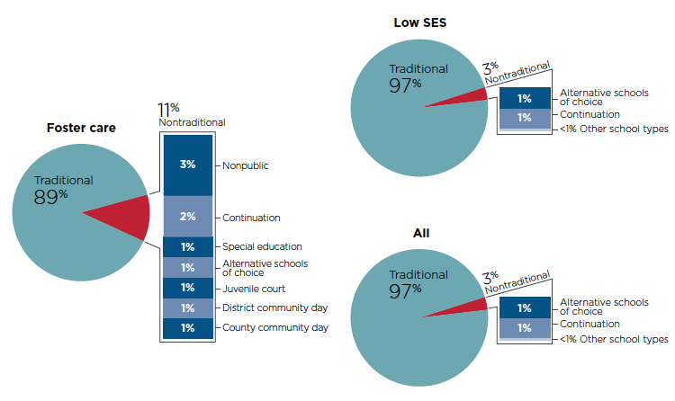
Figure 8 Percentage of students in foster care, low SES students, and all students enrolled in nontraditional public schools by type of school of enrollment, 2009/10

Slide 14
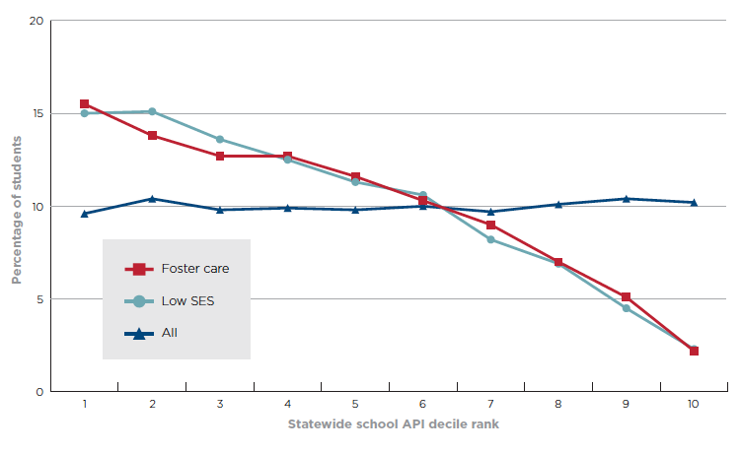
Figure 9 Percentage of students in foster care, low SES students, and all students by statewide school API decile rank of the school attended, 2009/10

Slide 15
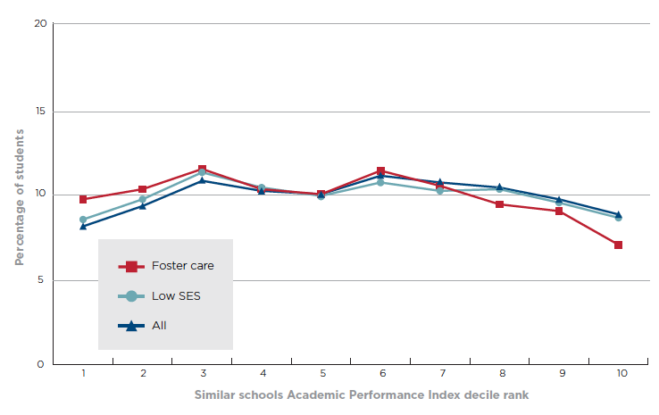
Figure 10 Percentage of students in foster care, low SES students, and all students by State similar school API decile rank of the school attended, 2009/10

Slide 16
Key Findings
Academic achievement and education outcomes
Students in foster care had the lowest participation rate in California’s statewide testing program.
Statewide testing showed an achievement gap for students in foster care and other at-risk student groups.
High school students in foster care had the highest dropout rate and lowest graduation rate.

Slide 17
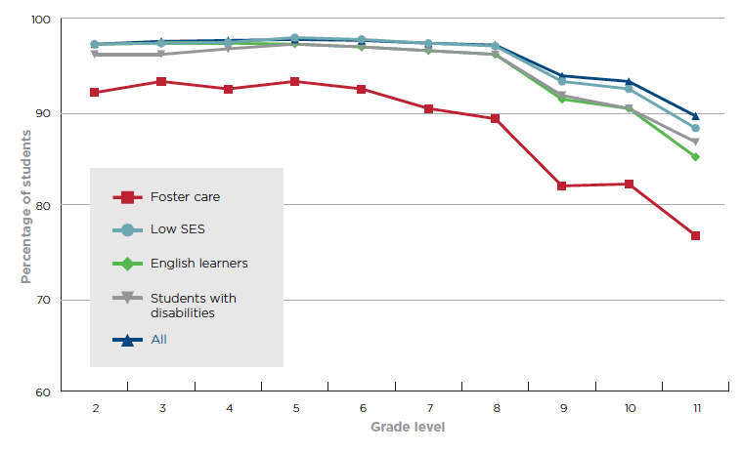
Figure 11 Percentage tested by grade for students in foster care, other at risk subgroups, and all students, 2009/10

Slide 18
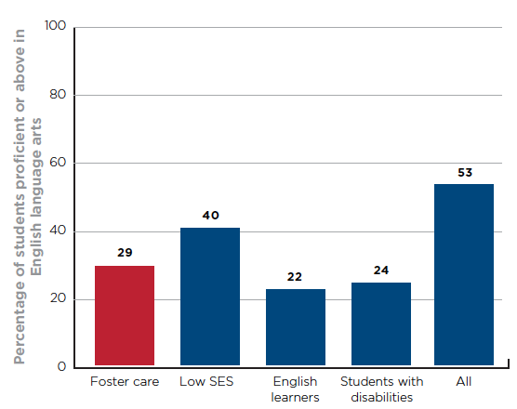
Figure 12 Percentage proficient or above for CST ELA results for students in foster care, other at risk subgroups, and all students, grades 2-11, 2009/10

Slide 19
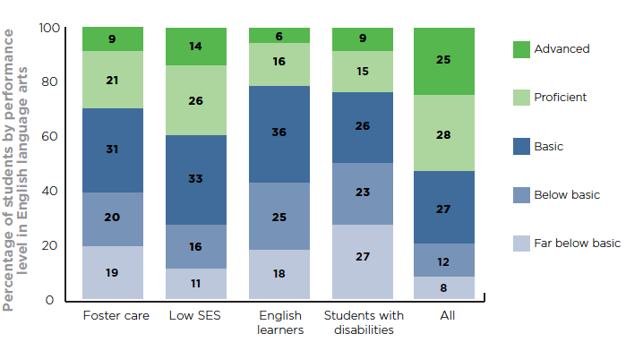
Figure 13 Percentage by performance level for CST ELA results for students in foster care, other at risk subgroups, and all students, grades 2-11, 2009/10

Slide 20
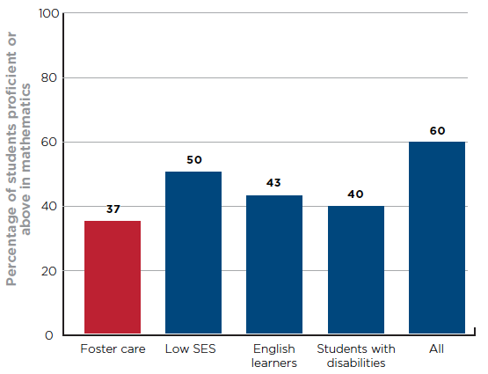
Figure 14 Percentage proficient or above for CST mathematics results for students in foster care, other at risk subgroups, and all students, grades 2-7, 2009/10

Slide 21
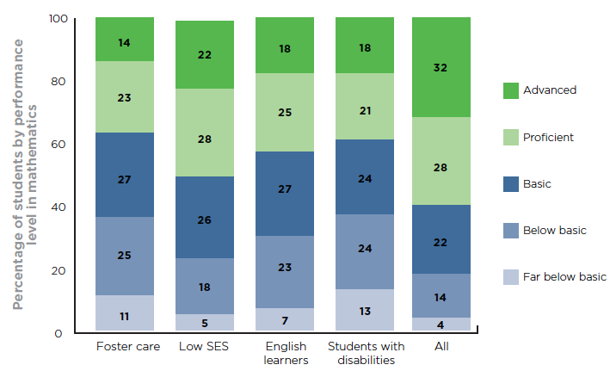
Figure 15 Percentage by performance levels for CST mathematics results for students in foster care, other at risk subgroups, grades 2-7, 2009/10

Slide 22
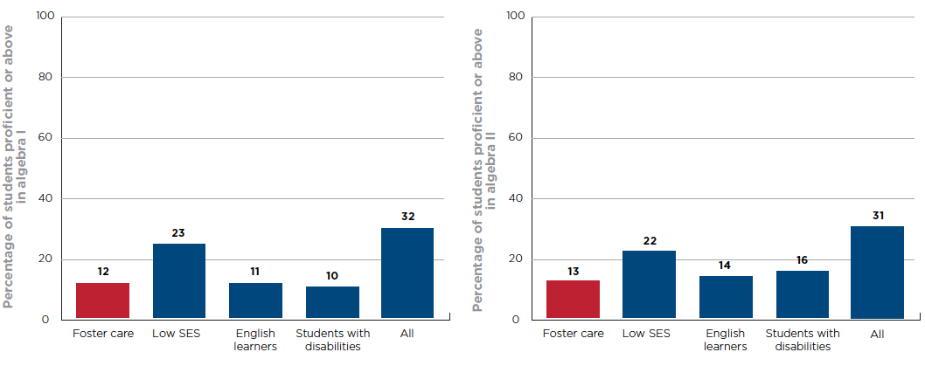
Figure 16 Percentage proficient or above for CST algebra I and II results for students in foster care, other at risk subgroups, and all students, 2009/10

Slide 23
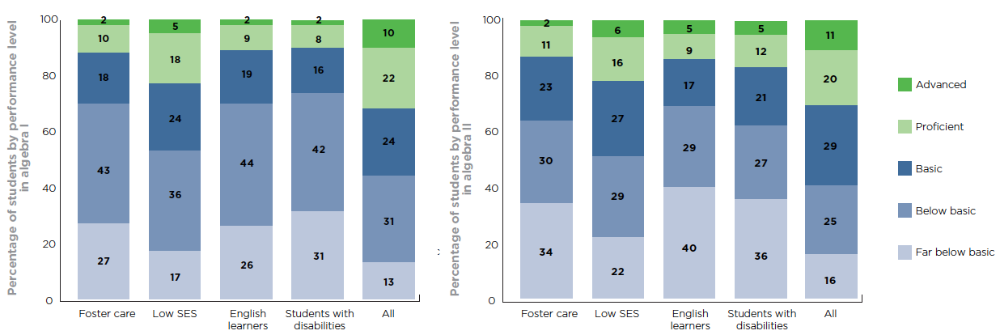
Figure 17 Percentage by performance levels for algebra I and II for students in foster care, other at risk subgroups, and all students, 2009/10

Slide 24
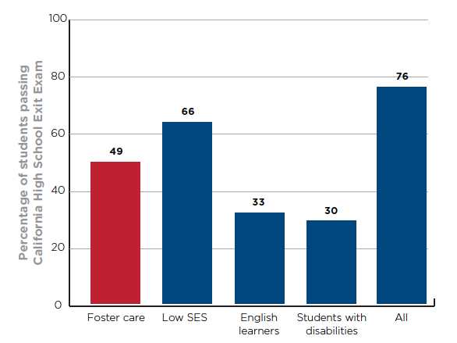
Figure 18 Percentage of tested Grade10 students who passed CAHSEE for students in foster care, other at-risk subgroups, and all students 2009/10

Slide 25
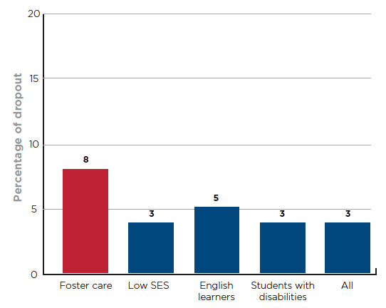
Figure 19 Single-year dropout rate for students in foster care, other at-risk subgroups, and all students, grades 9-12, 2009/10

Slide 26
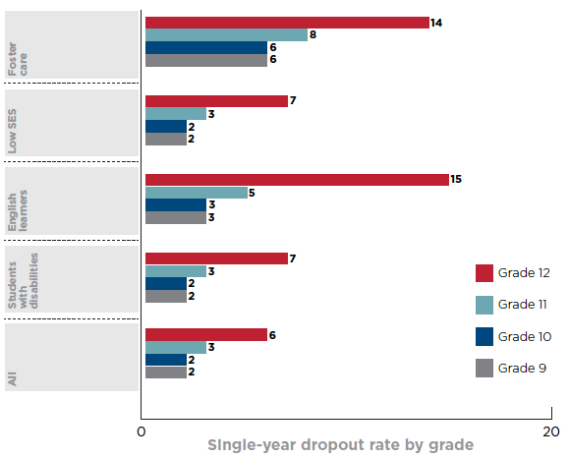
Figure 20 Single-year dropout rate by grade for students in foster care, other at-risk subgroups, and all students, grades 9-12, 2009/10

Slide 27
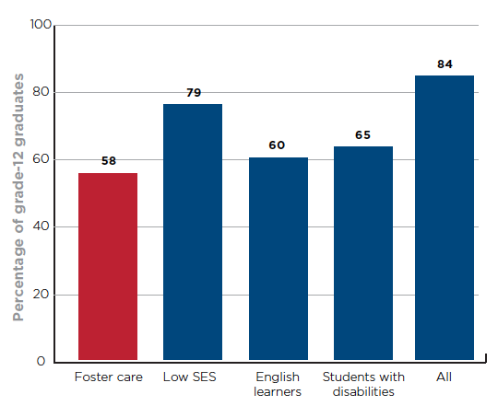
Figure 21 Grade 12 graduation rate for students in foster care, other a- risk subgroups, and all students, 2009/10

Slide 28
What’s Next?
Addressing the Invisible Achievement Gap —Areas of Focus for Improving Education Outcomes for California Students in Foster Care (November 2013)
The Invisible Achievement Gap, Part 2 —How the Foster-Care Experiences of California Public School Students Are Associated With Their Education Outcomes (2014)

Slide 29
For copies of the report:
www.cftl.org

