Slide 1
Facilitating Improvement in Teacher Practice
Learning Module 4
Needs Assessment and Problem Identification

Slide 2
Acknowledgments
This module series includes work that has been adapted from successful strategies developed by Alicia Bowman and Kim Austin for the Regional Educational Laboratory West (REL West) at WestEd.
We would like to acknowledge the Center for the Collaborative Classroom and Washoe County School District for their partnership in this work. We would also like to acknowledge the Carnegie Foundation for the Advancement of Teaching for its contributions to the field that are cited in this work.
Citation: Bowman, A., & Austin, K. (2021). Facilitating Improvement Professional Learning Modules—Module 4: Needs assessment and problem identification [Slide deck]. Washington, DC: U.S. Department of Education, Institute of Education Sciences, National Center for Education Evaluation and Regional Assistance, Regional Educational Laboratory West.
This product was funded under Contract ED-IES-17-C-0012 by Regional Educational Laboratory West administered by WestEd. The content of this product does not necessarily reflect the views or policies of the Institute of Education Sciences or the U.S. Department of Education, nor does mention of trade names, commercial products, or organizations imply endorsement by the U.S. government.

Slide 3
Welcome
Notes:
We recommend that you include a slide to introduce the facilitation team. This is also where you can build in an opportunity for participant introductions.

Slide 4
Community agreements
(Developed by the cohort in Module 1)
Notes:
Review the community agreements that you developed together during Module 1.
Remind participants that having and holding team members accountable to community agreements is one of the routines highlighted in the last session. Ask participants to identify an agreement for themselves that they would like to focus on for the day. They do not need to share what they selected.

Slide 5
Progress check-in
Introductions (name/role, if needed).
(2 minutes) Round-robin check-in:
In one word, how are you feeling today?
(8 minutes) Progress checks:
Since our last session, what have you been working on?
Has anything changed that impacts your work?
How is the group dynamic of your team (meeting success criteria)?
Closing.
Notes:
In small groups, ask each table to have a progress check-in. Remind participants that the check-in is another routine from the huddle process. It is another procedure that will become routine over time, and helps participants focus on the task at hand.

Slide 6
Learning arc for modules
Notes:
Explain that the first three sessions/modules focused on preparing to lead inquiry cycles. In this module, we begin to consider facilitation of the inquiry cycle itself, beginning with problem identification.

Slide 7
Improvement questions
We have four key improvement questions to improve our work:
1. What are our priority needs?
2. What is the problem we are trying to solve?
3. What might we change or introduce, and why?
4. How will we test and build confidence in our changes?
Source: Adapted from Langley (2009).

Slide 8
Learning targets
Use multiple methods to identify and prioritize areas for improvement.
Explore some methods for identifying a high-leverage problem to solve.
Consider the impacts of scope and scale of an improvement effort.
Notes:
As you describe the learning targets, mention some of the key points.
Key points:
• It is essential to fully understand a problem before trying to solve it.
• A needs assessment goes beyond quantitative data.
• Important data can be obtained from the individuals closest to the problem.
• Improvement problems are often complex but can be broken down to something that can be addressed.

Slide 9
Topics
Identifying your priority needs.
Identifying a problem to solve.
Locus of control, scope, and scale.

Slide 10
Identifying your priority needs

Slide 11
What is a needs assessment?
A deliberate process to identify the priority needs in your educational system, including some or all of the following:
Your district.
Your school.
Your teachers.
Your students and families.
Notes:
Using what you learned about systems in Module 2, tell participants that the needs assessment focuses on identifying problems at the system level, exploring leadership, context, culture, resources, and processes either above or below the surface.

Slide 12
What is a needs assessment?
During a needs assessment you will …
Review available data.
Review existing processes and procedures.
Examine multiple perspectives from your teachers, your students, and families.

Slide 13
Needs assessment process
The needs assessment process consists of three broad steps:
Initiation.
Data collection and analysis.
Summarizing findings and determining priorities.
Notes:
As you describe each step of the needs assessment process, ask participants to think about needs assessments they have participated in previously. What seems familiar, and what seems new? They can also highlight or underline these areas in their participant workbook.

Slide 14
1. Initiation
During initiation, the scope and scale of the needs assessment is determined, including:
What part of the educational system will be investigated.
Major questions you want to answer about your system.
Possible sources of information.
Who is responsible for each part of the assessment.
Source: Adapted from Weisberg (2019).

Slide 15
2. Data collection and analysis
During data collection and analysis, data are collected to answer the major questions that were surfaced about your system. These data are reviewed to identify trends and patterns.
Source: Adapted from Weisberg (2019).

Slide 16
3. Summarizing findings and determining priorities
After data are collected and analyzed, learning is summarized, and needs are prioritized. This information is used to clarify the current reality and identify a specific problem to solve.
Source: Adapted from Weisberg (2019).

Slide 17
Self-reflection
Which part of the needs assessment process is most familiar to you?
How is this the same as or different from other needs assessments you have participated in?
Notes:
Provide a few minutes for individual reflection in the workbook, and then ask if anyone would like to share their response with the group. Take four to five responses and move on.
Ask if the explicit focus on the system feels new or different to participants.

Slide 18
Starting a needs assessment
Next, we will share some common processes that are used when conducting needs assessments:
Data review.
Examining processes.
Empathy interviews.

Slide 19
1. Data review

Slide 20
Data review
Data for review will depend on the focus area you want to address. You should begin with data that already exist in your system. These data may include:
Academic assessment data.
Grades.
Attendance.
Discipline data.
Existing survey data.
Existing plans and documents.
Student work samples.

Slide 21
Self-reflection
What existing data sources are available in your context?
Which components of your educational system may not have available data?
Notes:
Remind participants that the components of a system are leadership, context, culture, resources, and processes either above or below the surface.
Provide a few minutes for individual reflection (participants can take notes in their workbook), and then ask if anyone would like to share their response with the group. Take four to five responses and move on.

Slide 22
Data analysis
To be useful, data should be collected and displayed in a manner that supports analysis for the focus area you want to better understand or address. For example:
Disaggregate data for student groups that have been historically underserved.
Use graphs and tables to organize data so you can see trends.
Once your data are organized, look for and identify patterns, surface questions, and identify additional data you might need to understand your context.

Slide 23
2. Examining processes

Slide 24
Examining processes
Identify processes that currently exist in the part of the system you are examining.
A process is all of the steps that come together to complete a task or produce a particular outcome.
Processes are a basic building block of systems and create a shared understanding of “how we do things.”
Notes:
Explain that systems are not static. They are dynamic, so we can’t just use single data point to understand a problem. Rather, we have to look at the processes that form the system and produce the outcomes we measure. Processes and procedures define “how we do things” at each level of the system. We look at both how consistent a process is and also whether deviations produce different results, either positive or negative.

Slide 25
Examples of processes
Systems | Processes
Discipline | Classroom rules and discipline process Office referral process Restorative circles
Attendance | Daily attendance taking Attendance notifications Parent/teacher communication School attendance and review board
Classroom instruction | Unit or lesson planning Daily reading instruction Instructional intervention Designated English language development (ELD) delivery

Slide 26
Examining processes
The simplest form of a process map is a flowchart.
A flowchart shows a series of steps that lead to a particular outcome.
Step 1
Step 2
Step 3
Step 4
Outcome

Slide 27
Examining processes
This is an example flowchart for the writing process.
Select a topic
Plan and outline
Write first draft
Revise and edit
Publish your writing

Slide 28
Examining processes
To examine all the steps in a process, you map out all the steps that you go through, noting any important transitions and decision points.
Having multiple people compare individual process maps can identify practices that are shared and where additional steps exist.
Examining your processes can also help you to identify:
Steps that should happen but do not.
Steps that take excessive time.
Steps that are particularly complex or difficult.
Places where the process bottlenecks.

Slide 29
Self-reflection
What are some processes that you want to examine more closely within the part of your system you are investigating (e.g., lesson planning, peer observation) ?
Can you think of some processes that are not done consistently and could be improved?
Can you think of any processes that are hard not to do or are hardwired into how you do business? How do you think they got that way? Are they producing the outcomes you want?
Notes:
Provide a few minutes for individual reflection in the workbook, and then ask if anyone would like to share their response with the group. Take four to five responses and move on.

Slide 30
3. Empathy interviews

Slide 31
Collecting needs assessment data from stakeholders
Individuals in your community have information to share that would help you better understand your needs.
You can collect these data by …
Surveying your community.
Talking to individuals using empathy interviews to better understand their experience in this part of your system.
Notes:
Share that empathy interviews are a way to gather stakeholder experiences and avoid jumping to solutions based on your personal experience and fast thinking. We will have an opportunity to observe an empathy interview. This can be an opportunity to identify a volunteer to be interviewed from your participants.

Slide 32
Self-reflection
What are some of the problems a principal or a group of teachers that you support may be experiencing? What are your current methods for understanding the problem and supporting them?
Notes:
Provide a minute for individual reflection, and then ask if anyone would like to share their response with the group. Take “popcorn” responses from the group.

Slide 33
Why empathy interviews?
Stakeholder engagement is a cornerstone of any planning process. Empathy interviews can help you better understand and connect with the school community you are serving by …
Seeing a system through the eyes of the individuals who experience it.
Listening to the expressed needs (and beginning to discover latent needs).
Hearing multiple perspectives about similar issues.
Challenging your assumptions and reserving judgment.

Slide 34
Empathy interviews
An empathy interview uses humble inquiry to help to understand the experiences, feelings, and needs of others.

Slide 35
Humble inquiry is ...
“Asking questions you don’t have the answer to … bolstered by an attitude of curiosity and genuine
interest in the other person.”
̶ Edgar H. Schein

Slide 36
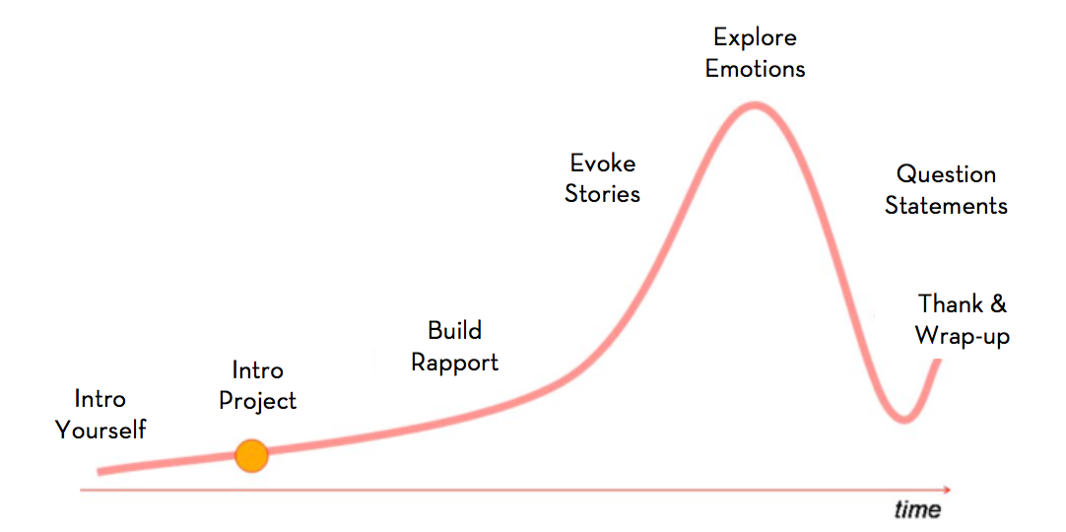
Arc of an empathy interview
Source: Both & Baggereor (2020).
Visual adapted from Michael Barry, Point Forward

Slide 37
Empathy interview simulation
Mock empathy interview with a volunteer
Notes:
Use the "Preparing for an Empathy Interview" handout from the facilitator's guide to help you identify an experience to investigate and to develop some questions for the simulation. Select a volunteer from the audience to do an empathy interview with. Interview the person in front of the rest of the group. Ask the participants to observe and makes notes in their workbooks of the types of questions that are asked.

Slide 38
Empathy interview reflection
Pair share:
What did you notice about the questions that the interviewer asked?
Notes:
Provide a minute for individual reflection, and then ask if anyone would like to share their response with the group. Relate responses to the arc of an empathy interview slide and the questioning guidelines.

Slide 39
Questioning guidelines
Avoid leading and close-ended questions.
Do you feel welcome at your school?
Begin with open-ended questions, and keep them neutral.
How would you describe your level of engagement with your school?
Ask for stories and concrete examples.
Can you share a story about an interaction you had with someone at the school regarding ... ?
Practice listening.
Don’t interrupt—let interviewees finish their thoughts.
Probe for emotions.
How did you feel when ... ?

Slide 40
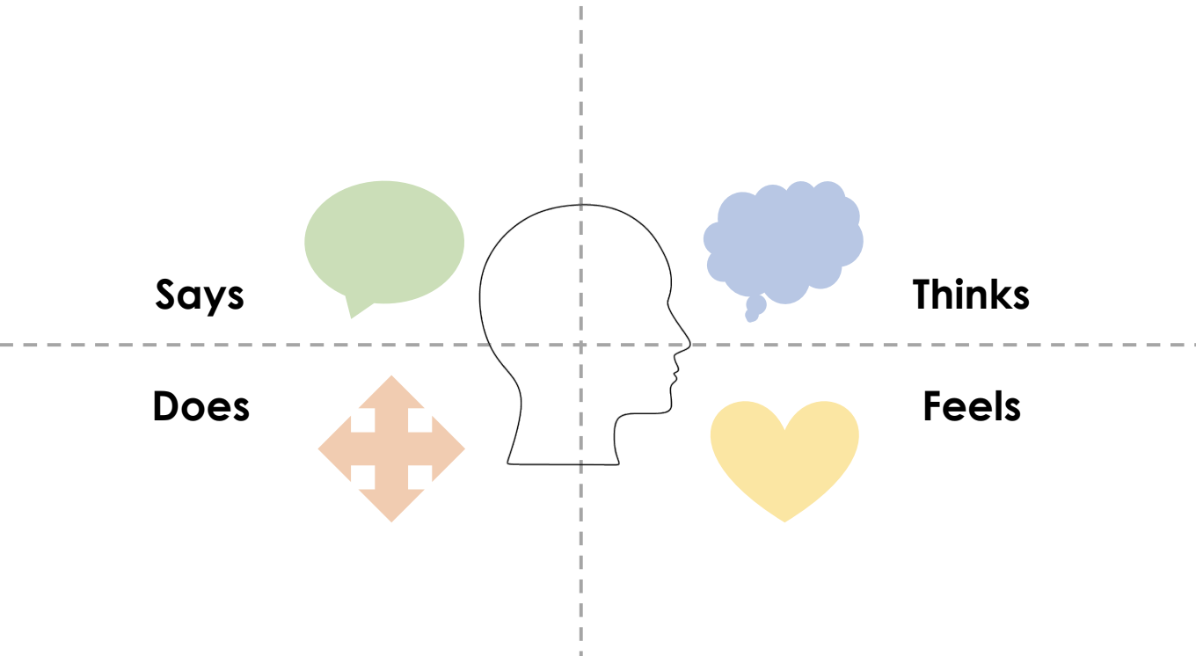
Empathy mapping
You can organize your notes or transcripts from empathy interviews into categories to better help you pull data out of the conversation.
Some common categories are these:
What do they say?
What do they do?
What do they think?
What do they feel?
Source: Both & Baggereor (2020).

Slide 41
Empathy mapping
On the left side of the map you record direct quotes and observations (says/does). On the right side of the map you make inferences (thinks/feels).
After completing the map, summarize any needs or new insights that have surfaced about the system or the issue you are investigating.
With multiple interviews, you can then compare insights and look for patterns.
Source: Both & Baggereor (2020).

Slide 42
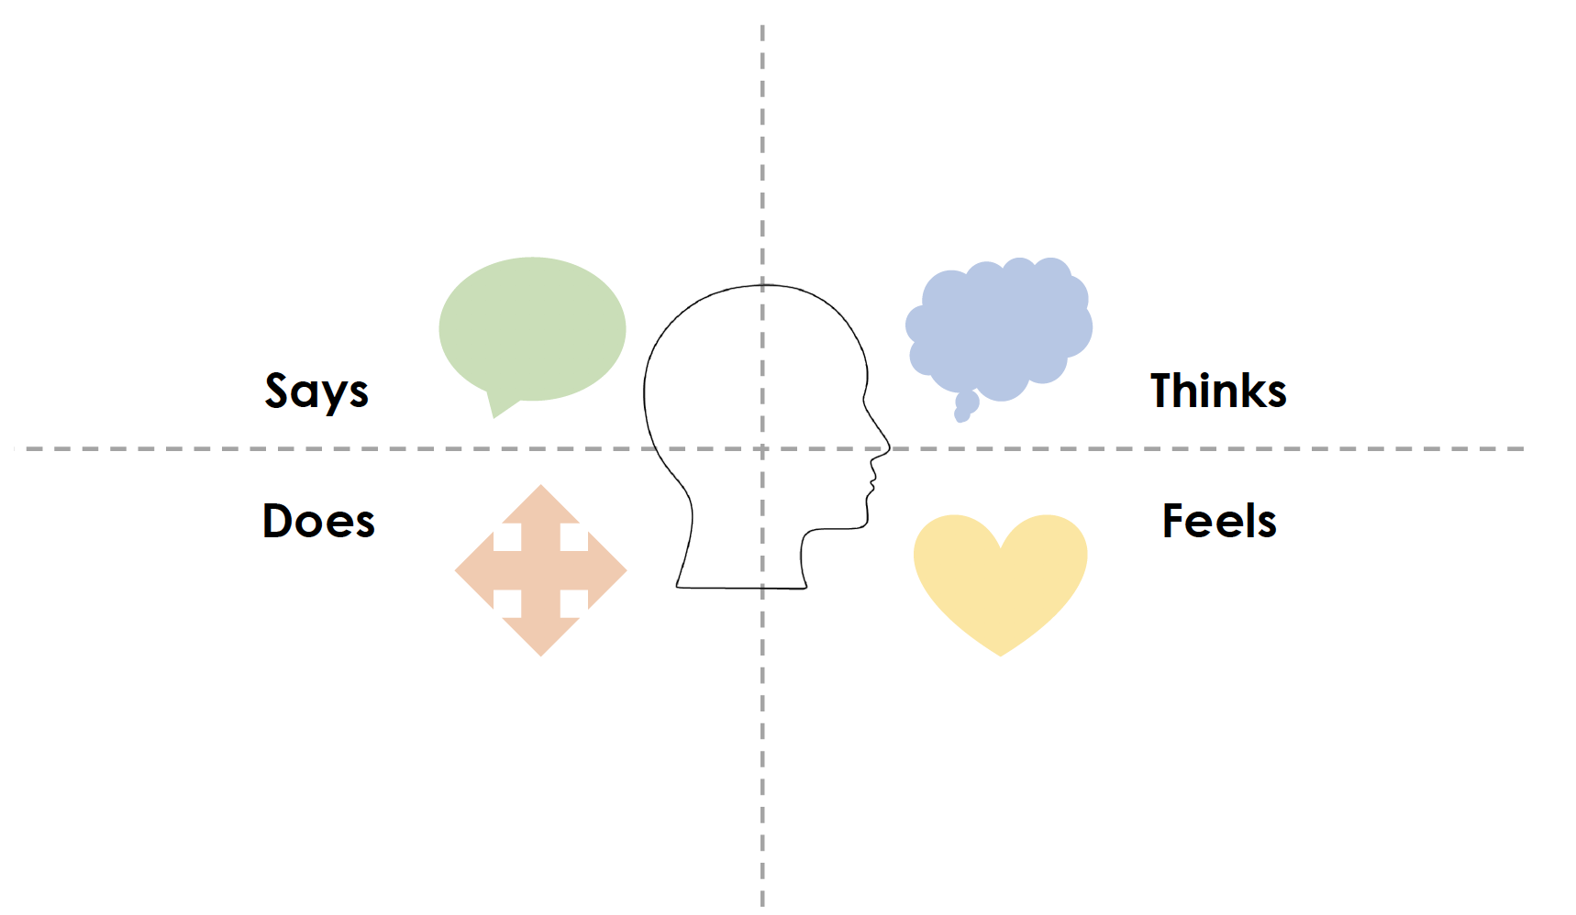
Example empathy map
“The best thing is when you see them make connections.”
“I observe my students to see what they understand, so I can help the students that don’t.”
“The problem is our materials don’t fit all of our student’s needs, and I have to search for supplemental materials.”
“I don’t have the training to meet every student’s needs.”
Thinks students are engaged.
Thinks there is never enough time to get everything done.
Thinks there is too much testing.
Thinks that more resources and support are needed.
Initially nervous.
Animated body language when talking about students.
Lots of hand gestures, smiles when talking about work.
Changes demeanor when talking about needs, closed body language.
Passionate.
Enjoys job.
Cares about students.
Uncomfortable talking about needs (in this setting).
Source: Both & Baggereor (2020).

Slide 43
Equity pause
EQUITY
PAUSE
How can empathy interviews be used to better understand the lived experience of historically underserved groups?
Why is it important to include these students and families explicitly in the needs assessment?
Notes:
This equity pause can be a small-group or whole-group discussion, depending on the size of your group. It is important that the discussion groups are small enough for everyone to be able to participate.

Slide 44
Identifying a problem to solve
Notes:
Explain to participants that now that they have gathered and reviewed their data, the next step is to identify the specific problem in their system they are trying to solve.

Slide 45
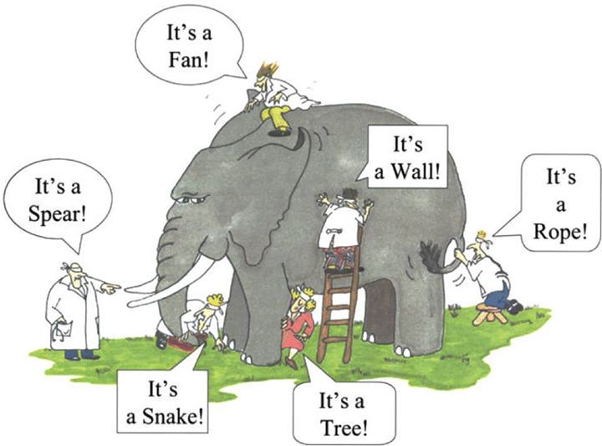
Understand where your problem is situated in your system.

Slide 46
Identify a problem to solve
Begin with understanding your system:
Review existing available data.
Reflect on any gaps in processes or procedures that are involved in the issues you are examining.
Talk to individuals in your system to understand what barriers they feel are in the way of improving outcomes.

Slide 47
Identify a problem to solve
When selecting a problem, choose ...
A problem you care about.
A problem that is a barrier to your organization’s priorities.
A problem that is regularly occurring.
A problem that is within your control.
A problem that has the right level of specificity.
A problem that does not include an implied solution.
Source: Bowman, Dolle, & Takahashi (2019).
Notes:
Ask participants to read the slide or the list in their notebook. In describing the problems, give examples of each.
A problem you care about—use your own example.
A problem that is a barrier to your organization’s priorities—use your own example.
A problem that is regularly occurring—such as flat assessment results.
A problem that is within your control (can be solved by your direct action, not the actions of someone else)—such as parents helping their children with their homework.
A problem that has the right level of specificity (something clear and focused enough to be tested in your context)—such as a morning meeting routine.
A problem that does not include an implied solution—for example, “a new reading curriculum will solve our reading comprehension problems” includes an implied solution.

Slide 48
Pair share
Think about the challenges you are facing. Within those challenges, which ones meet these criteria?
A problem you care about.
A problem that is a barrier to your organization’s priorities.
A problem that is regularly occurring.
A problem that is within your control.
A problem that has the right level of specificity.
A problem that does not include an implied solution.
Notes:
Participants can reflect briefly using the same prompt in their workbook and then do a pair share.

Slide 49
Locus of control, scope, and scale
Notes:
Specificity and frequency

Slide 50
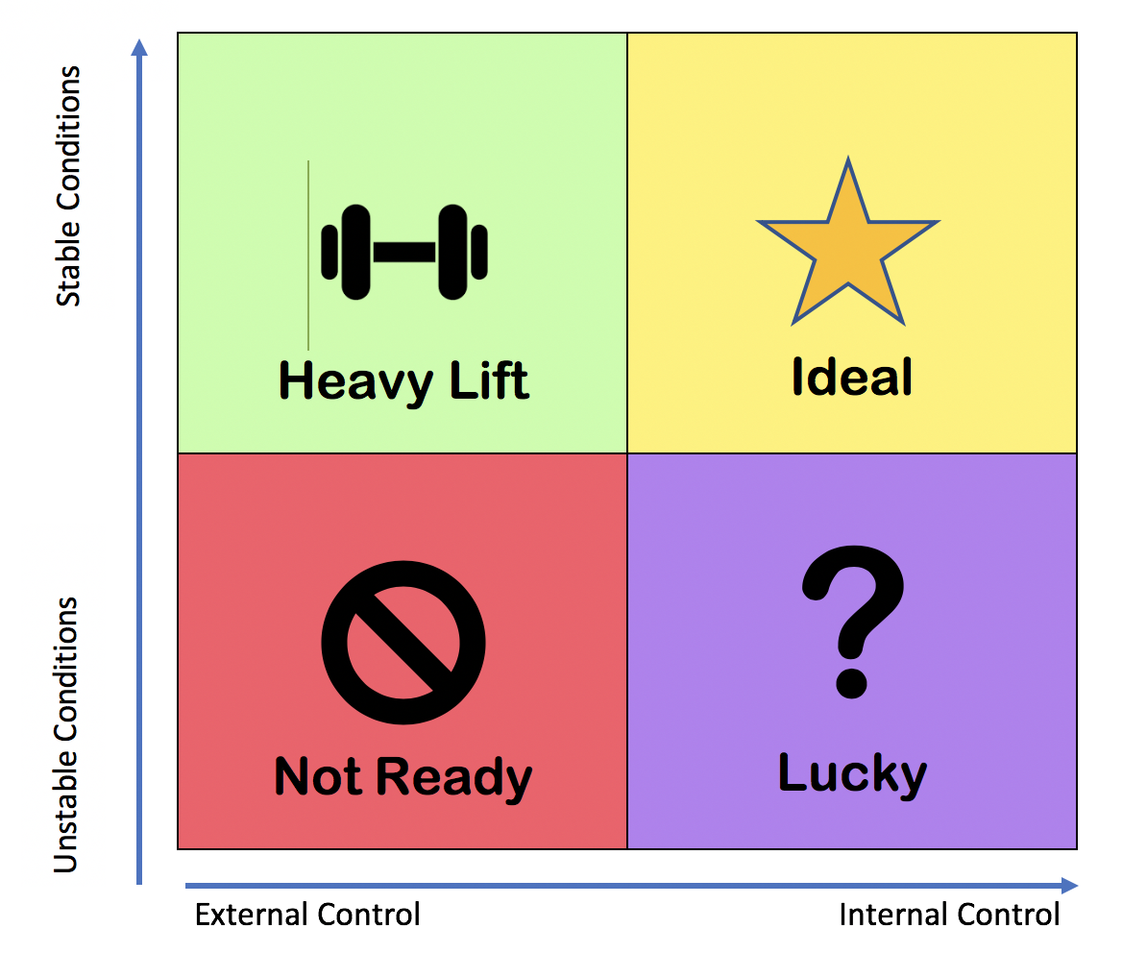
Locus of control
To be within your locus of control, your problem should be something that you, or someone on your team, can directly influence.
Source: Bowman, Dolle, & Takahashi (2019).

Slide 51
Locus of control activity
Please share:
Give an example of a problem that may be outside a team’s locus of control.
Notes:
You may ask for shout-out responses for this question for in-person settings or use the chat for online facilitation.

Slide 52
Locus of control activity
Trio sorting activity:
Sort the problems into the four quadrants to identify the locus of control. Discuss your reasoning.
Poverty.
Student performance.
Instructional practice.
Class size.
Curriculum.
Student behavior.
Notes:
Participants can complete this activity using their workbooks. Explain that depending on the system level (classroom, school, district) or the conditions, there might be different answers. For example, class size might not be within the locus of control of the teacher, but it might be within the locus of control at the district level. Teachers in some districts may have more control over curriculum choices than in others. Because conditions vary, specifying whether a problem is in the locus of control is an important conversation.

Slide 53
Problem scope
You need to select a problem that is focused enough to be clear to everyone and broad enough that it has multiple possible solutions.
Notes:
Needing multiple possible solutions is acknowledging that there is no singular solution to a given problem. Problems are context driven, and a solution for one student may be different from the solution for another. For example, a family communication strategy may need to use telephone, email, and text to be successful.

Slide 54
Problem scope
Broad and vague
“I’m not healthy!”
“I don’t exercise enough!”
“I don’t have an exercise schedule to follow every week!”
SPECIFICITY
Embedded solution
Source: Gunrow & Park (2017).

Slide 55
Problem scale
Improve transition time after lunch in a classroom.
Improve math fact fluency for a small group of students.
Improve daily student work completion in a classroom.
Improve 3rd grade reading fluency in a school.
Decrease schoolwide disciplinary incidents.
Improve K–3 ELA proficency in a district.
Less required
More required
Source: Adapted from Gunrow & Park (2017).
Notes:
Explain that by resources here you mean staff, time, and fiscal resources. Participants should also consider the number of students who will be affected by the change.

Slide 56
Problem scale
Questions to consider:
How many people are involved?
What resources will be required?
How much time will it take to solve the problem you selected?
How frequently can you obtain data to measure progress on this problem?

Slide 57
Problem scale
What resources will it take to solve?
1
2
3
4
5
6
Improve transition time after lunch in a classroom.
Improve math fact fluency for a small group of students.
Improve daily student work completion in a classroom.
Improve 3rd grade reading fluency in a school.
Decrease schoolwide disciplinary incidents.
Improve K–3 ELA proficiency in a district.
Less required
More required
Source: Adapted from Gunrow & Park (2017).

Slide 58
Problem scale
What resources will it take to solve?
1
2
3
4
5
6
Improve transition time after lunch in a classroom.
Improve math fact fluency for a small group of students.
Improve daily student work completion in a classroom.
Improve 3rd grade reading fluency in a school.
Decrease schoolwide disciplinary incidents.
Improve K–3 ELA proficiency in a district.
Less required
More required
What number on the scale is a problem you are considering for your team?
Source: Adapted from Gunrow & Park (2017).
Notes:
You may ask for a few responses for this question for in-person settings or use the chat for online facilitation.

Slide 59
Group discussion
As you think about the scope and scale of your projects, what questions are coming up for you?
Notes:
Participants can first do a silent reflection in their workbooks. Then you can ask participants to share their responses verbally or to write them on sticky notes for you to collect.

Slide 60
An improvement story: Lemmon Valley 3rd grade team
Through the remainder of the modules, we are going to be using the work of the 3rd grade team at Lemmon Valley Elementary School as an example of how this work can evolve in a real school context.
Notes:
You may choose to share the Lemmon Valley 3rd grade team improvement story using the video. You can show the entire video or just part of the video, through the section on identifying a problem, and save the rest for subsequent modules.
Learning to Improve Instruction: One Team’s Story, https://youtu.be/icO9IkmXurw

Slide 61
An improvement story: Lemmon Valley 3rd grade team
Lemmon Valley was in its second year of participating in the Literacy Improvement Partnership with a focus on improving writing instruction.
At the time, the school was using Collaborative Classroom’s Being a Writer curriculum and was using improvement methodology to improve teacher practice and student writing quality.

Slide 62
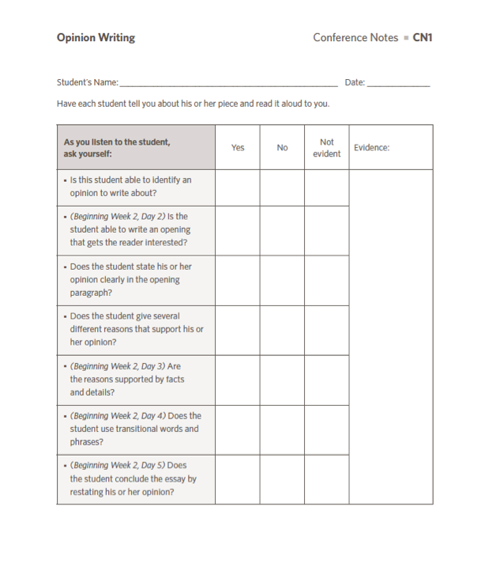
An improvement story: Lemmon Valley 3rd grade team
After considering places to improve their writing instruction and looking at best practices, the 3rd grade team members decided that providing formative feedback to students was an evidence-based practice that they wanted to improve.
The problem was, they were not reaching all students as frequently as they felt they needed to.
Initial goal: confer with every student at least once a week.

Slide 63
Equity pause
EQUITY
PAUSE
The writing curriculum in our improvement story called for meeting with all students throughout the week.
When thinking about meeting with students “as frequently as they needed to,” what equity issues do you think the team members needed to consider?
What other data do you think would have been helpful for the team to look at?
Notes:
This equity pause can be a small-group or whole-group discussion, depending on the size of your group. It is important that the discussion groups are small enough for everyone to be able to participate. Possible issues include whose needs are being met when meetings take place with students as frequently as needed—the student’s or the teacher’s? If a uniform approach is decided on to meet teacher scheduling needs, would students have access to equitable support?

Slide 64
Next steps

Slide 65
Module review
During this module our learning targets were to …
Use multiple methods to identify and prioritize areas for improvement.
Needs assessment:
Data review.
Examining processes and procedures.
Empathy interviews.
Explore some methods for identifying a high-leverage problem to solve.
Problem identification.
Consider the impacts of scope and scale of an improvement effort.
Locus of control, scope, and scale.
Notes:
As you review the module content, mention some of the key points.
Key points:
• It is essential to fully understand a problem before trying to solve it.
• A needs assessment goes beyond quantitative data.
• Important data can be obtained from the individuals closest to the problem.
• Improvement problems are often complex but can be broken down to something that can be addressed.

Slide 66
Action period for Module 4
Site-level needs assessment:
Identify a focus area to investigate.
Plan and conduct empathy interviews.
Identify data sources.
Plan and facilitate a team meeting:
Review and analyze data.
Begin to clarify the problem you are trying to solve.
Use meeting success criteria to monitor team dynamics.
Notes:
Review the action period activities with the group and make sure to answer any questions.

Slide 67
Closing reflection
Please share:
What is one new idea or learning you are leaving with today?
Notes:
Have people share aloud during in-person settings or in the chat for online participation.
This is also an opportunity to include a feedback survey.

Slide 68
References
Anaissie, T., Cary, V., Clifford, D., Malarkey, T., & Wise, S. (2021, June 7). Creative Commons Equity-centered design framework. Stanford d.school. Retrieved December 17, 2021, from https://dschool.stanford.edu/resources/equity-centered-design-framework
Barth, R. (2002). The culture builder. Educational Leadership, 59(8), 6–11. Retrieved December 28, 2021, from https://www.ascd.org/el/articles/the-culture-builder
Bay Area Coalition for Equitable Schools (BayCES). (2004). A guide to data-based inquiry: Using the cycle to drive learning and change for equity. BayCES, Oakland, CA.
Boston Consulting Group (2014). Teachers know best: Teachers’ views on professional development. Seattle, WA: Bill and Melinda Gates Foundation.
Both, T., & Baggereor, D. (2020, April 30). Design thinking bootcamp bootleg. Stanford, CA: Stanford d.school. https://dschool.stanford.edu/resources/the-bootcamp-bootleg
Bowman, A. (2011). Sphere of success [Activity]. National Equity Project, Oakland, CA.
Bowman, A. (2012). Things people say [Activity]. Alliance Learning Solutions.
Bowman, A., Dolle, J., & Takahashi, S. (2019). Improvement Science Institute [Presentation]. San Francisco, CA: WestEd.
Bryk, A., Gomez, L. M., Grunow, A., & LeMahieu, P. G. (2015). Learning to improve: How America’s schools can get better at getting better. Cambridge, MA: Harvard Education Press.
Bryk, A., Sebring, P. B., Allensworth, E., Luppescu, S., & Easton, J. Q. (2010). Organizing schools for improvement: Lessons from Chicago. Chicago, IL: University of Chicago Press.
Carnegie Foundation for the Advancement of Teaching, https://www.carnegiefoundation.org, retrieved April 22, 2021.
Center on School Turnaround. (2017). Four domains for rapid school improvement: A systems framework. San Francisco, CA: The Center for School Turnaround at WestEd.
Council of Chief State School Officers. (2013, April). InTASC Model Core Teaching Standards and Learning Progressions for Teachers 1.0: A resource for ongoing teacher development. Washington, DC: CCSSO.
Cristol, K., & Ramsey, B. S. (2014). Common Core in the districts: An early look at early implementers. Washington, DC: Thomas Fordham Institute.

Slide 69
References
Dana, N. F. (2014). The reflective educator's guide to classroom research: Learning to teach and teaching to learn through practitioner inquiry. Thousand Oaks, CA: Corwin Press.
Dechurch, L., Mesmer-Magnus, J., & Doty, D. (2013). Moving beyond relationship and task conflict: Toward a process-state perspective. Journal of Applied Psychology, 98(4), 559–578. https://doi.org/10.1037/a0032896
Desimone, L., Smith, T. M., & Ueno, K. (2006, April). Are teachers who need sustained, content-focused professional development getting it? An administrator’s dilemma. Educational Administration Quarterly, 42(2), 179–215.
Desimone, L. M. (2009, April 1). Improving impact studies of teachers’ professional development: Toward better conceptualizations and measures. Educational Researcher, 38(3), 181–199. https://journals.sagepub.com/stoken/rbtfl/hYeKyHG/tlbNA/full
Ermeling, B. A. (2009, February 2). Tracing the effects of teacher inquiry on classroom practice. Teaching and Teacher Education, 26(3), 377–388. https://doi.org/10.1016/j.tate.2009.02.019
Fong, P. (2020, December). Now is the time for teachers to use data-based inquiry cycles. Insights & Impact. REL West at WestEd. Retrieved December 28, 2021, from https://www.wested.org/wested-insights/rel-west-data-based-inquiry-cycles/#.
Graham, S., Bollinger, A., Booth Olson, C., D’Aoust, C., MacArthur, C., McCutchen, D., & Olinghouse, N. (2012). Teaching elementary school students to be effective writers: A practice guide (NCEE 2012- 4058). Washington, DC: National Center for Education Evaluation and Regional Assistance, Institute of Education Sciences, U.S. Department of Education. Retrieved from http://ies.ed.gov/ncee/ wwc/publications_reviews.aspx#pubsearch.
Grossman, P., Loeb, S., Cohen, J., Hammerness, K., Wyckoff, J., Boyd, D., et al. (2010). Measure for measure: The relationship between measures of instructional practice in middle school English language arts and teachers’ value-added scores. Cambridge, MA: National Bureau of Economic Research.
Gunrow, A, & Park, S. (2017). Creative Commons Improvement Science Coaching [Presentation]. Licensed by C.C. BY-NC-SA.
Gürdür, D., & Törngren, M. (2018). Visual analytics for cyber-physical systems development: Blending design thinking and systems thinking. Stockholm, Sweden: NordDesign, Department of Machine Design, KTH Royal Institute of Technology.
Hamilton, L., Halverson, R., Jackson, S., Mandinach, E., Supovitz, J., & Wayman, J. (2009). Using student achievement data to support instructional decision making (NCEE 2009-4067). Washington, DC: National Center for Education Evaluation and Regional Assistance, Institute of Education Sciences, U.S. Department of Education. Retrieved from https://ies.ed.gov/ncee/wwc/PracticeGuide/12
Heckman, J. (2017, February 6). The Achievement Gap starts at birth. The Heckman Equation. Retrieved September 15, 2021, from https://heckmanequation.org/resource/starts-at-birth/

Slide 70
References
Hough, H. J., Kerbow, D., Bryk, A., Pinnell, G. S., Rodgers, E., Dexter, E., et al. (2012). Assessing teacher practice and development: The case of comprehensive literacy instruction. School Effectiveness and School Improvement: An International Journal of Research, Policy and Practice 24(4). https://doi.org/10.1080/09243453.2012.731004
Hough, H., Willis, J., Gunrow, A., Krausen, K.., Kwon, S., et al. (2017, November). Continuous improvement in practice. Policy Analysis for California Education. https://www.edpolicyinca.org/publications/continuous-improvement-practice
Kana, J., Kramer, M., & Senge, P. (2021, July 8). The water of systems change. FSG. Retrieved December 17, 2021, from https://www.fsg.org/publications/water_of_systems_change
Kegan, R., & Lahey, L. L. (2001). How the way we talk can change the way we work: Seven languages for transformation. San Francisco, CA: Jossey-Bass.
Langley, G. J., Moen, R., Nolan, K. M., Nolan, T. W., Norman, C. L., & Provost, L. P. (2009). The Improvement Guide. John Wiley & Sons.
Lipton, L., & Wellman, B. M. (2012). Got data? Now what?: Creating and leading cultures of inquiry. Bloomington, IN: Solution Tree Press.
National Equity Project, https://www.nationalequityproject.org/, retrieved December 20, 2020.
Read, J. D. (1983). Detection of Fs in a single statement: The role of phonetic recoding. Memory & Cognition, 11(4), 390–399. https://doi.org/10.3758/bf03202454
Tuckman, Bruce W. (1965). Developmental sequence in small groups. Psychological Bulletin, 63, 384–399.
Valdez, A., Takahashi, S., Krausen, K., Bowman, A., & Gurrola, E. (2020). Getting better at getting more equitable: Opportunities and barriers for using continuous improvement to advance educational equity. San Francisco, CA: WestEd.
Weisberg, A. (2019, January 29). How to conduct needs assessment part 1: What is it and why do it? NC State Industry Expansion Solutions. Retrieved December 17, 2021, from https://www.ies.ncsu.edu/blog/how-to-conduct-needs-assessment-part-1-what-is-it-and-why-do-it/

